Slide 1
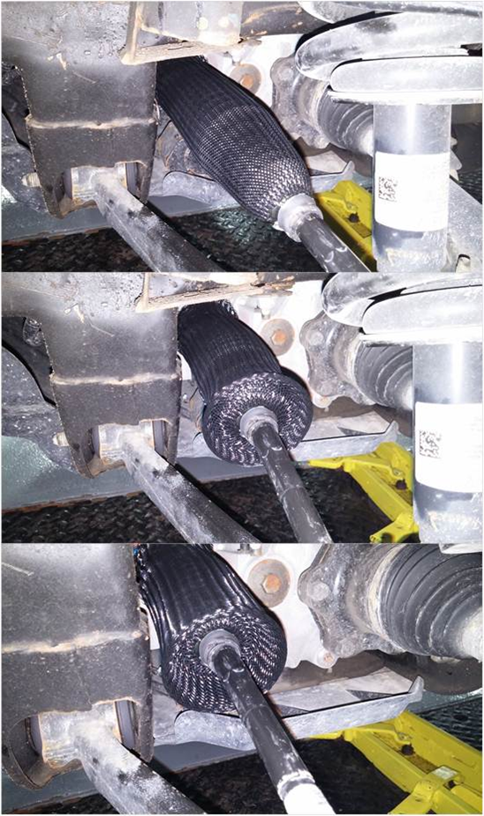
EPS Boot Protection
Project Scope: to provide protection to the R/P boots that will not affect boot performance.
Focused on protecting normal road chips and debris, while allowing for full range of normal boot motion, collapse, expansion
Not focused on protection against special causes: Assembly plant mis-handling, or dealership damage
Proposal: Flexible Plastic woven sock attached at housing or tie rod with clamps.
Fits over existing boot
No changes required to boot, housing or tie rod
Provides protection against common road chips, stones, etc
Allows for full range of boot motion -- will not affect boot collapse/expansion performance
Total cost per gear: ~$2.00 - 2.50 per gear asm
Cost vs. Warranty Savings Comparison
Do we save enough in Warranty to justify the cost?
Should we proceed with this project?

Slide 2
EPS Boot Protection
K2XX Warranty Cost Analysis – 36 Months in Service
2015 Model Year | 6.48 Total IPTV @ 36 MIS |  |  | $9.41 Total CPV @ 36 MIS
7.6% Boot Issues |  | 0.49 IPTV @ 36 MIS |  |  | $0.72 CPV @ 36 MIS
Warranty 50/50 Split |  | $0.36 CPV Nexteer Cost |  |  | $0.36 CPV GM Cost
2015 MY Volume |  | 1,069,388 Vehicles
Potential Cost |  | $384,980 Nexteer Cost |  |  | $384,980 GM Cost
98% Claims LoA

Slide 3
EPS Boot Protection
Potential Cost Increase not Savings
Cost increase of $2.00-$2.50 is more than we would save in Warranty – Nexteer only responsible for 3yr Warranty span
Warranty Cost per gear = $0.36 – Nexteer liability for 3yr K2XX
Boot Protector Cost per gear = $2.00-$2.50 (includes clamps and asm)
K2XX Longterm Warranty – Nexteer Not Currently Responsible
10yrs – 1.63 IPTV -- $2.40 CPV (100% GM Responsibility after 3yrs)
15yrs – 2.40 IPTV -- $3.60 CPV (100% GM Responsibility after 3yrs)
Conclusion
Boot Sleeve Cost is much higher than Nexteer’s 3 year Warranty cost
GM may feel justified to pay for protective sleeve to offset their longterm warranty cost beyond 3 years

Slide 4
EPS Boot Protection
Additional Factors to Consider
Boot Sleeve is intended to prevent road debris – it will not protect against all the various types damage we see in Warranty returns
Many damaged boots show evidence of puncture by sharp object (screw driver, oetiker removal tool, etc). Boot Sleeve will not prevent this kind of damage
Silao assembly plant was damaging boots by impacting gear /boot into frame cross member during assembly – damaged boots made it into the field and Nexteer shared cost of this per the current Warranty agreement. Boot Sleeve will not prevent this kind of damage
Boot Sleeve will not eliminate Warranty Cost entirely
Difficult to quantify how many boots are damaged by road debris vs other causes (dealership service, assembly plant, warranty tear down, etc.)
If we assume the boot sleeve will prevent even 75% of total boot warranty
Nexteer will still see $0.09 CPV in Warranty cost (saving $0.27 of original $0.36)
Nexteer has $0.27 to spend on a solution (to break even)
GM will see longterm warranty cost: 10yr = $0.60 CPV; 15yr = $0.90 CPV
Will GM invest $2.50 (plus our markup) to save $1.80 (10yr) or $2.50 (15yr)?

